Slide 1
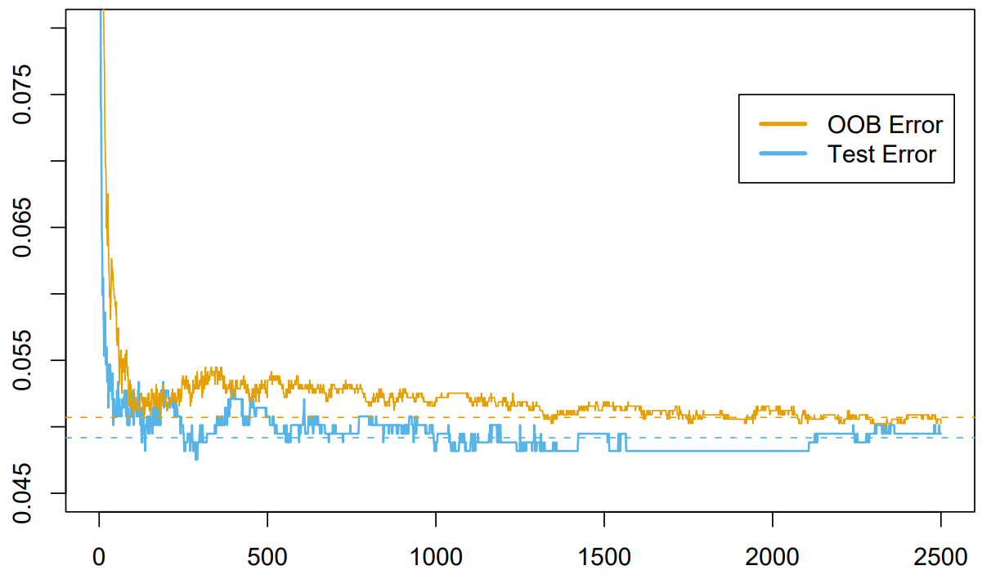




$$OOB Error$$
$$Test Error$$
$$Misclassification Error$$
$$Number of Trees$$

